Slide 1
Chapter 7: Reliability part 3

Slide 2
Introduction
Importance of psychological measurement.
Key aspects of reliability.
  Foundation of a test’s psychometry.
  Evaluating psychological measurement.
  Crucial in various applied behavioral practices.
Notes:
Importance of psychological measurement: Psychological measurement is crucial for research and application of behavioral science.
Key aspects of reliability:
Reliability is foundation of a test’s psychometric quality.
It is fundamental to understanding and evaluating psychological measurement.
It plays an important role in applied practice of behavioral science, in behavioral research, and in test construction and refinement.

Slide 3
Applied Behavioral Practice: Evaluation of an Individual’s Test Score (1 of 11)
Making decisions that shape people’s lives.
Implication of reliability of test scores.
Information used to evaluate test score.
  Point estimate: a specific value.
  Confidence interval: a range of values.
Notes:
Making decisions that shape people’s lives:
Psychological test scores are used to make decisions that shape people’s lives.
Example:
Intelligence tests are used by courts to evaluate eligibility for the death sentence for convicted murderers.
Certain special classes based on intelligence and achievement test scores are used to shift children from standard classrooms.
Tests like GRE and SAT are used for colleges and by employers while hiring and during promotion.
Implication of reliability of test scores:
It has a crucial implications for the quality of decisions made on the basis of psychological test scores.
Scores of these tests indicate or estimate true level of an individual’s psychological attribute.
Information used to evaluate test score:
Point estimate: A specific value that is interpreted as the“best estimate” of an individual’s standing on a particular psychological attribute.
Confidence interval:
Reflects a range of values that is often interpreted as a range in which the true score is likely to fall.
Logic: An observed score is simply an estimate of a true score.
If an individual’s score has a narrow confidence interval, then the score is a fairly precise point estimate of the individual’s true score.
If an individual’s score has a wide confidence interval, then the score is an imprecise or inaccurate point estimate of the individual’s true score.

Slide 4
Applied Behavioral Practice: Evaluation of an Individual’s Test Score (2 of 11)
Point Estimates of True Scores
Two kinds of point estimates:
  First: based on individual observed test score (most common)
  Second: an adjusted true score estimate.
Notes:
Two kinds of point estimates:
First and most commonly used point estimate is based solely on an individual’s observed test score which means that when a test is taken the score derived can be used as a point estimate.
Second type of point estimate, sometimes called an adjusted true score estimate, takes measurement error into account.
Observed scores is affected as it may be altered due to factors like fatigue, distraction, and so on.
Test taken in two different occasions will give two different individual test scores and observed scores.
Both of those observed test scores could be considered point estimates of the individual’s true score.
Understanding reliability and the nature of measurement error, an person’s observed score can be used from one testing occasion to estimate the score that the person would get if we tested the individual repeatedly.
This produces an adjusted true score estimate, which reflects an effect called regression to the mean.

Slide 5
Applied Behavioral Practice: Evaluation of an Individual’s Test Score (3 of 11)
Point Estimates of True Scores
Regression to the mean:
  Applies to relatively extreme scores.
  Prediction is based on CTT and random measurement error.
Notes:
Regression to the mean:
It applies to scores that are relatively extreme at a first testing occasion.
If a respondent has scored highly in first testing then it is likely to be little lesser (close to mean) than the high obtained in the second testing.
If a respondent has scored very low in the first testing, then it is likely to be little higher (closer to mean) than the low obtained in the second testing.
This prediction is based on the logic of classical test theory (CTT) and random measurement error.

Slide 6
Applied Behavioral Practice: Evaluation of an Individual’s Test Score (4 of 11)
Discrepancy reflected by adjusted true score.
Factors responsible for the size and direction of the discrepancy.
  Reliability of the test scores
  Extremity of the observed score
Notes:
Discrepancy reflected by adjusted true score: The adjusted true score estimate is supposed to reflect the discrepancy in an individual’s observed scores that is likely to arise across repeated testing occasions, due to regression to the mean.
Factors responsible for the size and direction of the discrepancy:
The reliability of the test scores.
The extremity of the individual’s observed score.
Direction of the difference between the observed score and the mean of the those scores.

Slide 7
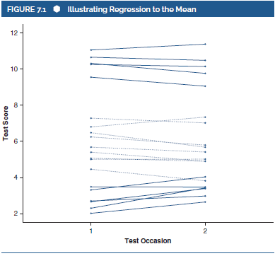
Applied Behavioral Practice: Evaluation of an Individual’s Test Score (5 of 11)
Notes:
Figure 7.1: Illustrating regression to the mean.

Slide 8
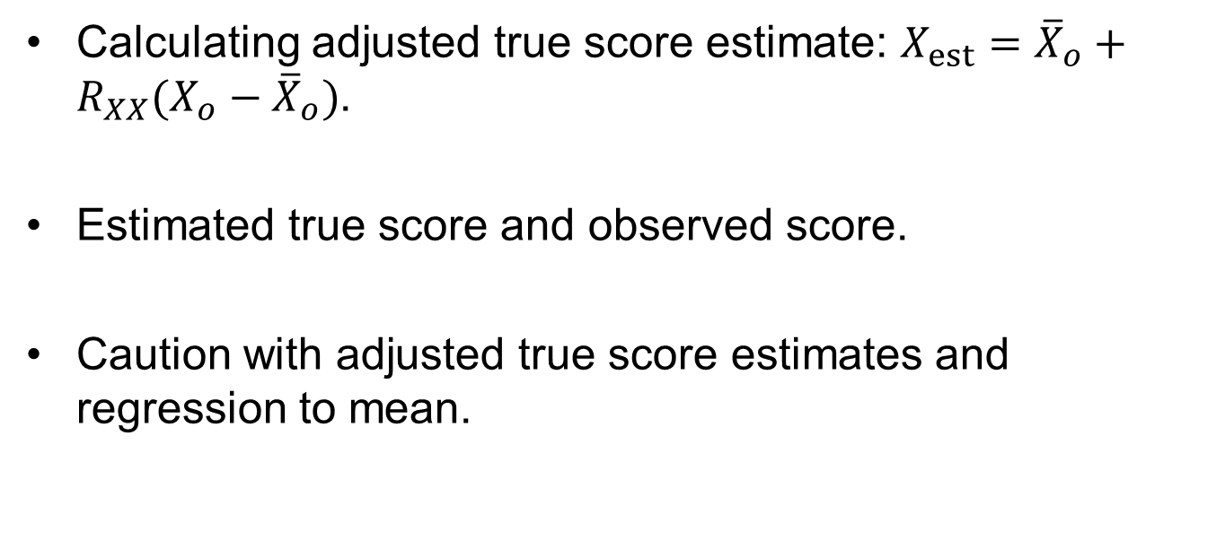
Applied Behavioral Practice: Evaluation of an Individual’s Test Score (6 of 11)
Calculating adjusted true score estimate: $X_{est}={\overline{X}}_{o}+R_{XX}(X_{o}−{\overline{X}}_{o})$.
Estimated true score and observed score.
Caution with adjusted true score estimates and regression to mean.
Notes:
Calculating adjusted true score estimate:
It is calculated using the equation: $X_{est}={\overline{X}}_{o}+R_{XX}(X_{o}−{\overline{X}}_{o})$, where:
X_{est} is the adjusted true score estimate,
${\overline{X}}_{o}$ is the test’s mean observed score,
R_{XX} is the reliability of the test scores, and
X_{o} is the individual’s observed score.
Estimated true score and observed score:
Reliability influences the difference between the estimated true score and the observed score.
Reliability and difference between the adjusted true score estimate and the observed score increases are inversely proportional to each other.
The observed score’s extremity influences the difference between the estimated true score and the observed score.
The difference will be larger for relatively extreme observed scores (high or low) than for moderate scores.
Caution with adjusted true score estimates and regression to means:
Except when we intend to predict a person’s score on a subsequent test or when we wish to form a confidence interval, there maybe little reason to correct observed scores by adjusting them for regression to the mean.
Though most psychologists think that regression to the mean is, in the long run, a mathematical certainty, it does not occur always.

Slide 9
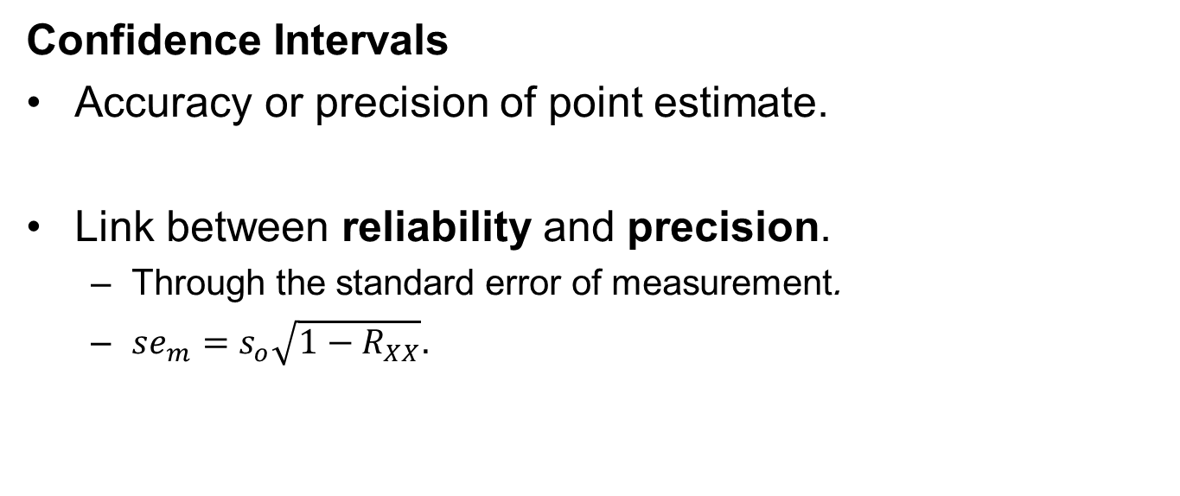
Applied Behavioral Practice: Evaluation of an Individual’s Test Score (7 of 11)
Confidence Intervals
Accuracy or precision of point estimate.
Link between reliability and precision.
  Through the standard error of measurement.
  $se_{m}=s_{o}\sqrt{1−R_{XX}}.$
Notes:
Confidence intervals:
They reflect the accuracy or precision of the point estimate as an indicator of an individual’s score.
Example:
Suppose we administer the Wechsler Intelligence Scale for Children (WISC) to a child and find that the child gets a score of 106, taking this observed score as true score we calculate a confidence interval and conclude that we are “95% confident that the individual’s true IQ score falls in the range of 100–112.”
Here, the 12 point range reflects the precision of the point estimate.
Link between reliability and precision:
It is made through the standard error of measurement (se_{m}):
The se_{m} represents the average size of the error scores that affect observed scores and they are directly proportional to each other.
The se_{m} can be seen as an index of measurement error, and it is closely linked to reliability.
Equation for link between the standard error of measurement (se_{m}), reliability (R_{XX}), and the standard deviation of a test’s observed scores (s_{o}): $se_{m}=s_{o}\sqrt{1−R_{XX}}.$

Slide 10
Applied Behavioral Practice: Evaluation of an Individual’s Test Score (8 of 11)
Computing confidence interval around estimated true score.
  95% confidence interval = X_{est} ± (1.96)(se_{m}).
Precisions of high and low reliable tests.
Notes:
Computing confidence interval around estimated true score:
For a 95% confidence interval around that score, we use the following equation: 95% confidence interval = X_{est} ± (1.96)(se_{m}), where:
X_{est} is the adjusted true score estimate (i.e., a point estimate of the individual’s true score).
se_{m} is the standard error of measurement of the test scores.
The final component (1.96) reflects the fact that we are interested in a 95% confidence interval rather than a 90% interval or any other “degree of confidence.”
Precisions of high and low reliable tests:
Highly reliable tests produce narrower confidence intervals than less reliable tests.
The size of this range reflects the precision of the confidence interval which means the smaller the interval, the more precise the observed score is as an estimate of the true score.
Even though high reliability produces narrow intervals, low reliability produces wider confidence intervals, that reflects a less precise estimate of the true score.

Slide 11
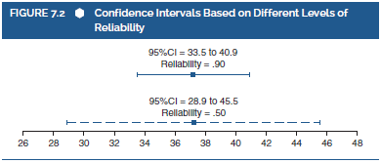
Applied Behavioral Practice: Evaluation of an Individual’s Test Score (9 of 11)
Notes:
Figure 7.2: Confidence intervals based on different levels of reliability.

Slide 12
Applied Behavioral Practice: Evaluation of an Individual’s Test Score (10 of 11)
Debate and Alternatives
Variations in computation and integration of confidence intervals:
  Use of various degrees of confidence.
  Use of standard error of measurement.
  Application to observed/adjusted true scores.
Notes:
Variations in computation and integration of confidence intervals:
Confidence intervals can be computed for various degrees of confidence (e.g., 99% or 90% or 68% instead of 95%).
They can be computed by using either the standard error of measurement or a related value called the standard error of estimate (which is also affected by reliability).
They can be applied to either observed score estimates of true scores or adjusted true score estimates.

Slide 13
Applied Behavioral Practice: Evaluation of an Individual’s Test Score (11 of 11)
Implications for exact interpretation of confidence interval.
  According to true score theory, observed scores are distributed normally around true scores.
  Since an observed score is the best estimate of a true score, the observed score represents the mean of this distribution.
Notes:
Implications for exact interpretation of confidence interval:
The various alternatives have implications for the exact interpretation of the confidence intervals.
Dudek’s view on typical computation:
With reference to the typical computation of confidence intervals, Dudek objects to interpretations such as “There is a 95% chance that the true score falls within the confidence interval” because answers of this type imply that true scores are deviating around an observed score.
He is of the opinion that such interpretations require use of the adjusted true score estimate, along with a different version of the standard error.

Slide 14
Test Construction and Refinement (1 of 6)
Reliability as an important consideration.
Factors affecting internal consistency reliability.
Attention to consistency among parts of a test.
Interconnected item characteristics.
Notes:
Reliability as an important consideration:
High reliability is desirable for any psychological test or type of measurement.
Hence, reliability is an important consideration in the processes of test construction and refinement.
Factors affecting internal consistency reliability:
Test length: With all things being equal, a longer test produces more reliable scores than a shorter test.
Consistency among the parts of a test: A test with greater internal consistency will produce more reliable scores than a test with lower internal consistency.
Attention to consistency among parts of a test:
In the process of test construction and refinement, great attention is paid to the consistency among the parts of a test, typically in terms of the test items themselves.
Various statistical characteristics of a test’s items are examined by test developers in order to identify items that should be removed from the test or to look for items that should be revised to enhance their contribution to the test’s psychometric quality.
Items that improve a test’s internal consistency are preferable to items that detract from the test’s internal consistency.
Interconnected item characteristics in the process:
Item means: item difficulty.
Item variances.
Item discrimination: The overarching issue of reliability which is closely connected to internal consistency.

Slide 15
Test Construction and Refinement (2 of 6)
Conducting psychometric analysis.
Use of statistical packages to conduct analysis.
Testing scores with greater reliability.
Notes:
Conducting psychometric analysis:
The psychometric analysis should be conducted for each score that is produced by a test, with a score representing each psychological dimension underlying the responses to the test’s items.
For a unidimensional test, we would conduct psychometric analyses on all of the test’s items together as a single group, and for a multidimensional test, we would conduct psychometric analyses separately for each of the test’s dimensions.
Statistical packages used to conduct basic reliability analyses:
Many statistical packages can be used to conduct basic reliability analyses.
Example: In the statistical package SPSS, the “reliability analysis” is used to conduct these analyses.
Testing scores with greater reliability:
By doing this, we might wish to refine the test in a way that could improve its reliability for future use.
The results of our analyses will help us examine the degree to which each item enhances or detracts from the test’s quality, and this information can guide any test refinements.

Slide 16
Test Construction and Refinement (3 of 6)
Item Discrimination and Other Information Regarding Internal Consistency
Degree of consistency of test items.
Determining items contributing to and detracting from reliability.
Interitem correlation matrix.
Notes:
Internal consistency:
It is the degree to which differences among persons’ responses to one item are consistent with differences among their responses to other items on the test.
Any test’s internal consistency is intrinsically linked to the correlations among its items.
If an item is relatively strongly correlated with the other items on a test, then that item is generally consistent with those items.
If an item is relatively weakly correlated with other items on a test, then that item is generally inconsistent with those items.
Determining items contributing to and detracting from reliability:
It can be done by looking at the correlation among a test’s items.
This might be included in a reliability-based test construction or refinement process.
Interitem correlation matrix:
Can be used to present correlations among test’s items.
Issues: Test development/refinement situations can be much more complicated, with many more items and with a more complex pattern of correlations.
Thus, an examination of a matrix of interitem correlations might be somewhat impractical with real data.

Slide 17
Test Construction and Refinement (4 of 6)
Item discrimination: differentiation based on scores.
Item–total correlation.
Corrected item–total correlations.
Notes:
Item discrimination:
The degree to which an item differentiates people who score high on the total test from those who score low on the total test.
From the perspective of reliability, we prefer items that have high discrimination values than low discrimination values.
Item-total correlation:
The degree to which differences among persons’ responses to the item are consistent with differences in their total test scores.
A high item–total correlation indicates that the item is consistent with the total test scores, which is determined by all of the test items.
A low item–total correlation indicates that the item is inconsistent with the test as a whole, which would be undesirable from the perspective of reliability.
“Corrected” item–total correlations:
Correlations between an item and a “corrected” total test score.
To compute a corrected item–total correlation for each item, SPSS computes a different corrected total test score for each item.

Slide 18
Test Construction and Refinement (5 of 6)
Use of discrimination index for binary items.
Squared multiple-correlation index.
Cronbach’s alpha if item deleted value.
Ways of improving test’s reliability.
Notes:
Use of discrimination index (D) for binary items:
It compares the proportion of high test scorers who answered the item correctly with the proportion of low test scorers who answered the item correctly.
To obtain this, we identify a specific percentage of people with the highest total test score and the same percentage of people with the lowest total test scores.
Then, we calculate the proportion of people within each group who answered the item correctly.
Finally, we compute the item discrimination index by calculating the difference between these two proportions: D = p_{high} – p_{low}.
The item discrimination index ranges from 0 to 1.0, except in the unlikely case that high-scoring people are less likely to answer an item correctly than are low-scoring people.
We prefer items that have large D values, which would indicate that high scorers and low scorers differ dramatically in the likelihood of answering an item correctly.
Squared multiple-correlation index:
An index of the degree to which an item is linked to the other items.
Includes the R² values obtained when predicting “scores” on each item from the scores on all of the other items.
Can range from 0 to 1.0, with larger values typically preferred.
Drawback: It fails to differentiate between positive and negative associations among items, which is crucially important for purposes of reliability.
Cronbach’s alpha if item deleted value: This value tells us the reliability estimate that we would obtain for test scores if that item were dropped from the test.
Ways of improving test’s reliability:
One way is to drop the item that is inconsistent with other items in the test.
Other way is to revise the item to make it more consistent with the other items.

Slide 19
Test Construction and Refinement (6 of 6)
Item Difficulty (Mean) and Item Variance
Factors affecting item’s contribution to quality of test.
Correlation: degree of variability among variables.
Link between correlation and variance.
Link between variability and psychometric quality.
Notes:
An item’s mean and variance are the important factors affecting its contribution to quality of test.
Correlation:
It reflects the degree to which variability within one variable is consistent with variability within another variable.
It is dependent on variance wherein if a variable has no variability, then it will not be correlated with any other variable.
Link between correlation and variance:
Based on this, an item’s variance has potential implications for characteristics such as its interitem correlations, its item–total correlation, and its “alpha if item deleted” value.
Items with limited variability are less likely to have good correlational characteristics than are items with substantial variability.
Poor items from the perspective of reliability are the items that all respondents answer in the same way.
Link between variability and psychometric quality:
The link between an item’s variability and its psychometric quality can be extended to the item’s mean.
In a few cases, an item’s mean tells us about the item’s variability also.
If an item has no variability, then it is a poor test item from a reliability perspective.
So, items that have “extreme” means may have limited variability, and thus they are relatively likely to have poor psychometric qualities.

